Slide 1

Gardners Guide to Threat Intelligence
wehackpeople.com

Slide 2


Slide 3

Gartner Gardner
The most important list in modern-day business!
The “Bees Knees”
Kitties!

Slide 4
You’re going to want to listen to be on that list!

Slide 5
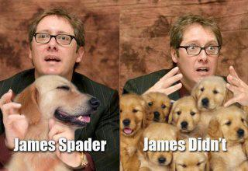
If you’re not on it, you’re nothing.

Slide 6
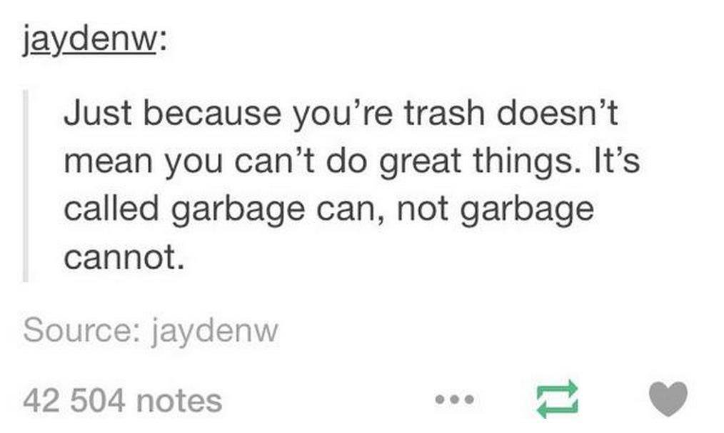
But, things can improve if you follow advice!

Slide 7

Do as they say!!!

Slide 8
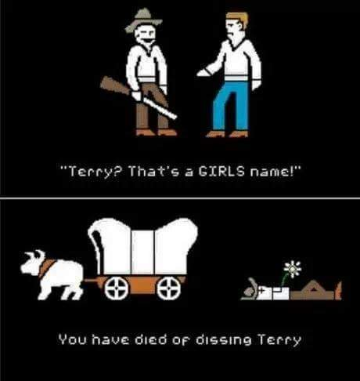
Do not speak ill of Gartner Gardner.
(It was nice knowing you, buddy!)

Slide 9

Study!!
You must read and study to understand.

Slide 10
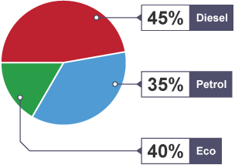
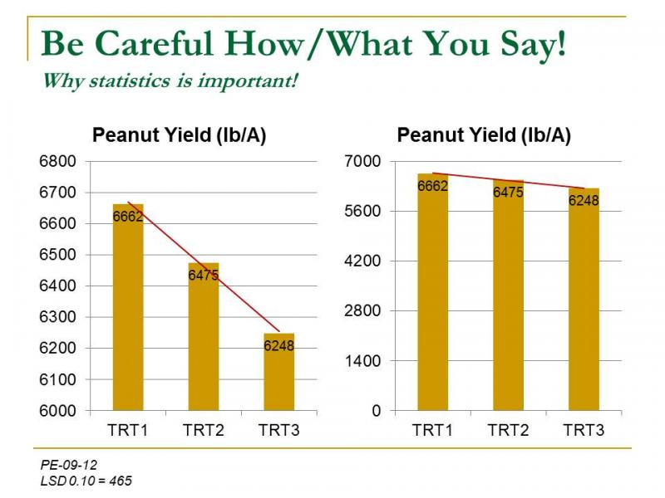
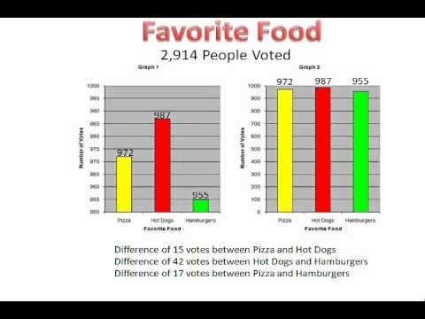
Read the charts!

Slide 11
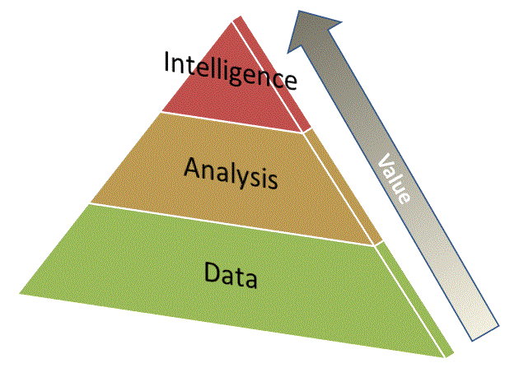

Slide 12
Questions?

